Slide 1
3D Printing 2014: A Survey of SmarTech’s Annual Market Findings
May, 2014 Charlottesville, Virginia

Slide 2
About Us
SmarTech Markets Publishing delivers industry analysis and market forecasts for the 3D printing/additive
manufacturing industry. Our coverage provides insight for those companies offering 3D printing
equipment, materials, services, and software, as well as companies who operate in industries where 3D
printing will begin to play a role in the near future.
When a company purchases a report from SmarTech Markets Publishing or engages us for
custom consulting, it receives:
SmarTech offerings complement internal product planning technology road-mapping, as well as provide low-cost
knowledge enhancement for firms in the 3D printing industry.
Comprehensive analysis that reflects today’s 3D printing market realities and tomorrow’s profitable possibilities
Detailed forecasts that provide our clients with compelling evidence to support important strategic decisions and give them an edge over the competition.
Actionable recommendations identifying where money will be made and where it will be lost.
Candid market assessments based on today’s best strategic thinking, not just data dumps from the Internet.

Slide 3
About Us (Cont.)
Our mission is to identify business opportunities in the areas of Additive Manufacturing (AM)/ 3D printing and other advanced manufacturing technologies
We use a proven market analysis process with roots that stretches back 30 years in the telecommunications industry
Our reports are focused on providing granular, comprehensive ten-year forecasts of revenue generation and market size for sectors of the AM industry. Our reports include forecasts of hardware, software, services, and materials, along with market size for potential applications
Our reports are intended as key strategic inputs for all senior executives planning 3D Printing product/market strategies and for investors who are looking to take equity positions in 3D Printing firms
SmarTech also offers customized consulting and due diligence analysis

Slide 4
Smartech Team
Lawrence Gasman
Lawrence Gasman is the founder of SmarTech Markets Publishing and is acknowledged worldwide as an expert on technology forecasting.
He has previously founded two other industry analyst firms and has also carried out a wide range of technology assessments in areas ranging from optical networking to advanced materials to
augmented reality.
Ian Forsyth
Forsyth is a Senior Business Analyst at SmarTech Markets Publishing, where his work covers the 3D printing, digital manufacturing and industrial automation sectors. Forsyth holds a Masters degree in Commerce from the University Of Virginia’s McIntire School of Commerce, where he specialized in strategy and
financial markets.

Slide 5
About The Report
In this report, SmarTech provides an insider perspective on the latest 3D printing opportunities in this dynamic market environment. We pinpoint where the smart money will go in the 3D printing sector and how firms will be changing their business models and processes to profit from 3D printing.
“3D Printing 2014: A Survey of SmarTech’s Annual Market Findings” begins with a thorough assessment of the 3D printing business climate in 2014, including an analysis of how things are changing in the materials space. It also evaluates the product/market strategies of the leading 3D printer firms: the ones that SmarTech sees shaping the 3D printing industry going forward.
The report then continues with 10-year projections and market analysis for all the leading sectors in which 3D printing is being deployed. Applications areas covered include: medical, dental, aerospace, automotive, and personal/educational. The reader of this report will find an application-by-application assessment of the opportunities for 3D printing including comprehensive and granular ten-year forecasts of hardware, software, and services.
SmarTech is the only firm completely dedicated to industry analysis in the 3D printing sector. As such, we have a unique understanding of new revenue generation, technology status, and strategic impact across the whole 3D printing sector.
“3D Printing 2014: A Survey of SmarTech’s Annual Market Findings” is designed for all forward thinking and innovative marketing, business development, and financial executives who need to understand where future business opportunities are headed. The objective of this report is to provide essential input to senior executives making marketing, business development, and investment decisions in the rapidly evolving 3D printing business.

Slide 6
Related Reports
Additive Manufacturing Opportunities in the Aerospace Industry: A Ten-Year Forecast | Published February 2014
3D Printing in Medical And Dental Markets: An Opportunity Analysis and Ten-Year Forecast : 2014-2023 | Published December 2013
Markets For 3D Printing Materials: 2013 - 2022 | Published September 2013
Personal 3D Printers: Market Forecasts and Market Share Analysis: 2013 - 2022 | Published August 2013

Slide 7
A Note On Forecasting Methodology
The forecasts generated for this report are the first of their kind: they are the most comprehensive, detailed market forecasts available anywhere.
The forecasts approach the 3DP industry at a granular scale, looking at each and every company current manufacturing 3DP equipment.
Additional information gathered from publically available financial statements, as well as over forty industry interviews were used to fill out the forecast.
Companies were grouped by similar organization, business processes, size, products, services, and management. We then were able to make assumptions on private companies based off on information that was available on public competitors.
Finally, we were able to create a three scenario analysis to project growth rates. We looked at both best case and worst case scenarios, as well as a conservation, middle of the road scenario. Ultimately, the conservative middle case is what was included in the report and comprise the forecasts that will be presented in this webinar.

Slide 8
A Note On Forecasting Methodology (cont.)
The fruits of these labors are a confidence that our customers can use these forecasts to reliably analyze new opportunities.
Summary market forecasts for the 3DP industry are broken out by product type and industry vertical. Summary market forecasts are broken out by equipment, materials, services, and software. Additionally, these market numbers are also broken into aerospace, medical, dental, auto, and personal/education verticals, as well as an “Other” category.
Within each industry vertical, the market is broken out by equipment, materials, services, and software. In addition, our forecasts provide printer unit volumes expected to ship by year for each vertical. Printer unit volumes are broken out by metal printers, plastic laser sinter printers, large format binder jetting printers, SL/SLA printers, FDM printers, and professional binder printers.

Slide 9
Roadmap For This Webinar
Four Biggest Themes In The 3DP In 2014
Four Key Take-Away’s From Our Market Forecasts
Overview of Primary 3DP Markets and Applications:
Aerospace
Medical
Dental
Automotive
Personal/Education
Four Biggest Questions Moving Forward for 2014 and Beyond

Slide 10
Four Largest Trends of 3DP in 2014 (1/4)
This is year that 3DP grew up
Increased capital expenditures; Accelerating production cycles
No longer a question of “if” for a mainstream technology, but “when”
Also means some growing pains
We are on the cusp of a tipping point in the industry
Too many people are emotionally invested in 3DP for it to fade

Slide 11
Four Largest Trends of 3DP in 2014 (2/4)
Equipment Manufacturers Gear Up Their Service Offerings
A number of important services acquisitions
Expansion of service centers
OEMs continuing to recognize the value of offerings services as a client development/sales tools
Also accelerates product development processes

Slide 12
Four Largest Trends of 3DP in 2014 (3/4)
OEMs Consolidate Materials Supply Chains
What happened in plastics is happening in metal also
Seeing a conceptual shift towards materials strategy
Early industry necessitated bring materials in house
Now, materials are seen increasingly as a core revenue generator
Materials companies are firing back
Höganäs, RTI Int’l, and Oxford Performance Materials…

Slide 13
Four Largest Trends of 3DP in 2014 (4/4)
3DP Companies Appeal to Public Markets for New Capital
Companies taking advantage of the market’s large appetite for 3DP
Are we on the top of the Gartner Hype Cycle?
A disappointing January…
Materialise & SLM Solutions

Slide 14
Roadmap For This Webinar
Four Biggest Themes In The 3DP In 2014
Four Key Take-Away’s From Our Market Forecasts
Overview of Primary 3DP Markets and Applications:
Aerospace
Medical
Dental
Automotive
Personal/Education
Four Biggest Questions Moving Forward for 2014 and Beyond

Slide 15
Four Key Take-Away’s From This Webinar
Takeaway #1:
Total Market For 3DP Related Goods and Services
 | 2013 | 2014 | 2015 | 2016 | 2017 | 2018 | 2019 | 2020 | 2021 | 2022 | 2023
Total Market (millions $) | 2010.3 | 2674.9 | 3724.3 | 4960.9 | 6271.3 | 7658.1 | 9279.5 | 11241.0 | 13544.1 | 16354.7 | 19363.6
CAGR |  | 33.1% | 39.2% | 33.2% | 26.4% | 22.1% | 21.2% | 21.1% | 20.5% | 20.8% | 18.4%

Slide 16
Four Key Take-Away’s From This Webinar
Takeaway #2:
 | 2013 | 2014 | 2015 | 2016 | 2017 | 2018 | 2019 | 2020 | 2021 | 2022 | 2023
Equipment As A % of Total | 45.6% | 46.7% | 46.8% | 46.8% | 46.8% | 46.7% | 46.8% | 46.9% | 47.0% | 47.0% | 48.1%
Material As A % of Total | 26.1% | 26.9% | 27.1% | 27.3% | 27.4% | 27.6% | 27.9% | 28.2% | 28.5% | 28.7% | 27.5%
Services As A % of Total | 23.1% | 20.4% | 19.7% | 18.8% | 17.9% | 17.0% | 16.3% | 15.7% | 15.1% | 14.5% | 14.2%
Software As A % of Total | 5.1% | 6.0% | 6.4% | 7.1% | 7.9% | 8.7% | 9.0% | 9.2% | 9.5% | 9.8% | 10.2%
Software’s relative market share increases over the forecast period
Material’s relative market share increases over the first half of the forecast period, then declines in the later half of the forecast period

Slide 17
Four Key Take-Away’s From This Webinar
Takeaway # 3:

Slide 18
Four Key Take-Away’s From This Webinar
Takeaway # 4:
Three Largest Opportunities By Industry Sector
 | 2014 | 2019 | 2023
1 | Personal/Education ($552 m) | Personal/Education ($1,945.3 m) | Dental ($4,312.9 m)
2 | Aerospace ($412.7 m) | Dental ($1,926.5 m) | Personal/Education (4,311.0 m)
3 | Dental ($509.0 m) | Medical ($1,798.8 m) | Medical ($3,571 m)

Slide 19
Roadmap For This Webinar
Four Biggest Themes In The 3DP In 2014
Four Key Take-Away’s From Our Market Forecasts
Overview of Primary 3DP Markets and Applications:
Aerospace
Medical
Dental
Automotive
Personal/Education
Four Biggest Questions Moving Forward for 2014 and Beyond

Slide 20
Aerospace
Opportunities:
Engine Components
Brackets, Hinges, & Cleats
Ducting
Electronic Housing
UAV’s
Military
Space
Issues:
Regulatory clearance
Interfacing with plane development cycles
Will savings be substantial enough to justify costs?

Slide 21
Medical
Opportunities:
Modeling
Cutting guides
Orthopedic implants
Specialty medical equipment
Issues:
Will 3DP be in the operating room?
Quality perception issues
Addressing load bearing implant applications

Slide 22
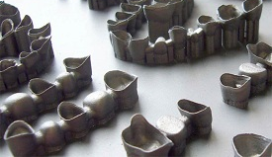
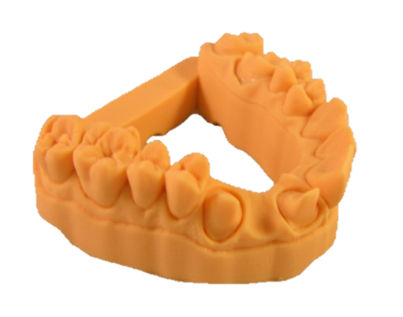
Dental
Opportunities:
Lost Wax Models
Dental stone models
Temporaries
Customized dental implants
Issues:
3DP in dental match industry trends
Will previous adoption of CNC help of hinder 3DP ?
What will adoption look like?

Slide 23
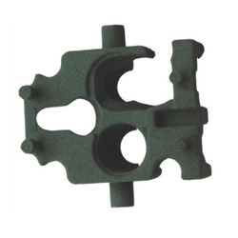
Automotive
Opportunities:
Functional prototyping
Tooling
Select sand core mold components
Customized interior inserts
Issues:
Replacement part market
Finding niche applications in a less ideal target market

Slide 24
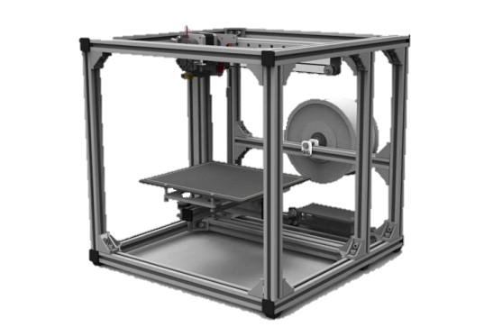
Personal/Education
Opportunities:
Prosumer printers
High-value, low-cost compact printers
Super-high end consumer printers
SL personal printers
Materials
Education
Issues:
Consumer market becoming more segmented
Patent issues
New entrants unsettling market balance

Slide 25
Roadmap For This Webinar
Four Biggest Themes In The 3DP In 2014
Four Key Take-Away’s From Our Market Forecasts
Overview of Primary 3DP Markets and Applications:
Aerospace
Medical
Dental
Automotive
Personal/Education
Four Biggest Questions Moving Forward for 2014 and Beyond

Slide 26
Four Biggest Questions Moving Forward
How fast can quality management (QM) systems be brought online?
Will the big guys jump in?
Will discontinuous innovation in the 3DP space continue?
Will plastics begin to replace metals?

Slide 27
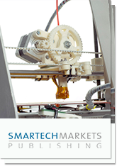
Information in these slides is taken from:
3D Printing 2014: A Survey of SmarTech’s Annual Market Findings
For more details of this report and any questions about other reports on the 3D printing industry, please contact Robert Nolan at:
Robert Nolan
804-938-0030
rob@ilumatech.com

Slide 28
Contact Us
Thank you for listening!
Please contact us during normal business hours of 8:30-5:30 East Coast time (US). You can also fill out our contact form at any time and we will follow up with you promptly.
PO Box 4353
Charlottesville, VA 22905
434-872-9008
434-872-9014
info@smartechpublishing.com
/SmarTechPublish
/channel/UCMC4wGazw3rEgKr0mMyeAtA
/company/3016246

